Slide 1

BACHELOR OF TECHNOLOGY IN
Artificial Intelligence and Machine Learning
Section : OMEGA
Project Title : COMPUTER VISION BASED PARKING SPACE DETECTION
Batch Number: OT-18
Roll Numbers :
2211CS020509[SIGMA]
2211CS020529[SIGMA]
2211CS020537
2211CS020573
2211CS020575
Project Guide: PREETI.C.M
Department of AIML, School of Engineering
Malla Reddy University

Slide 2
CONTENTS
INTRODUCTION:
Project Identification / Problem Definition
Objective of project
Scope of the project
ANALYSIS:
Project Planning and Research
Software requirement specification
Software requirement
Hardware requirement
Model Selection and Architecture
DESIGN:
Introduction
DFD/ER/UML diagram(any other project diagram)
Data Set Descriptions
Data Preprocessing Techniques
Methods & Algorithms
DEPLOYMENT AND RESULTS:
Introduction
Source Code
Model Implementation and Training
Model Evaluation Metrics
Model Deployment
Web GUI’s Development & Integration
Results : Testing , Validation & Final Results
CONCLUSION:
Project Conclusion
Future Scope

Slide 3
INTRODUCTION:
Welcome to our cutting-edge Parking Space Detection Application – the ultimate solution for hassle-free parking! In a world where finding a parking spot can often feel like searching for a needle in a haystack, our innovative technology comes to the rescue. With our application, drivers can bid farewell to circling endlessly in search of a vacant space and instead enjoy a seamless parking experience.Gone are the days of frustration and wasted time. Our application harnesses the power of advanced sensors and artificial intelligence to accurately detect available parking spaces in real-time. Whether you're navigating a bustling city center or a crowded parking garage, our solution provides you with the information you need to locate the nearest open spot efficiently.But our application offers much more than just space detection. With user-friendly interfaces and intuitive features, it simplifies the entire parking process. From reserving spots in advance to navigating to your designated space with ease, our application streamlines every aspect of parking.Join us as we revolutionize the way you park. Say goodbye to stress and hello to convenience with our Parking Space Detection Application.

Slide 4
PROJECT IDENTIFICATION:
Project Identification The Automated Parking Space Detection System is a comprehensive initiative designed to alleviate the common urban challenge of finding available parking spaces. This project leverages advanced image processing and machine learning techniques to detect and report real-time parking space availability. By integrating cameras and sensors to monitor parking areas, the system aims to provide accurate and up-to-date information to users via a mobile app or web interface. This project promises to enhance the overall parking experience, reduce traffic congestion, and improve the utilization of parking resources.
OBJECTIVE OF PROJECT:
The primary objectives of the Automated Parking Space Detection System are multifaceted. Firstly, it aims to significantly reduce the time drivers spend searching for parking by offering real-time information on available spaces, thereby enhancing efficiency. Secondly, it seeks to minimize traffic congestion in and around parking areas by providing clear guidance on available parking, which in turn reduces unnecessary driving. Thirdly, the project is focused on user convenience, ensuring that the system is reliable and easy to use. Additionally, it aims to optimize the utilization of parking spaces, ensuring maximum occupancy and minimizing wastage of space. Finally, the project intends to collect and analyze parking data to inform future urban planning and improve parking management strategies.

Slide 5
SCOPE OF THE PROJECT:
The scope of this project is extensive, encompassing several critical components. Initially, the project will involve the installation of high-resolution cameras and various sensors to monitor parking spaces. The development of robust image processing software and machine learning models will be crucial for accurately detecting and analyzing parking space occupancy. A key aspect of the project is the creation of a user-friendly mobile app and web interface, enabling users to check real-time parking availability. The project will start with a pilot implementation in a specific parking lot or garage and, based on the success of this phase, will expand to larger areas, including multiple parking facilities across a city or region. Key features of the system will include real-time detection of parking space occupancy, user notifications about available spots, optional parking reservation capabilities, and navigation assistance to guide drivers to the nearest available parking space. Data management will involve secure storage and sophisticated analytics to understand usage patterns and improve parking strategies. Integration with existing infrastructure and third-party services, such as navigation systems and city-wide traffic management, will be crucial for seamless operation. Additionally, ensuring data security and user privacy will be a top priority, with robust measures in place to protect sensitive information.

Slide 6
PROJECT PLANNING :
ANALYSIS:
1.1. Define Objectives and Scope:
-Objective: Develop an application that can detect and display available parking spaces in real-time.
-Scope: Define the specific features and functionalities, such as:Real-time parking space detection,User-friendly interface Integration with navigation systems,Alerts and notifications,Data analytics and reporting
1.2. Identify Stakeholders:
-End-users (drivers)
-Parking lot owners/managers
-Municipal authorities
- Development team
1.3. Requirements Gathering:
-Real-time detection and display of available spaces
-User registration and login
-GPS and map integration
-Payment processing (if applicable)

Slide 7
RESEARCH:
2.1. Market Research
-Analyze existing parking space detection apps (e.g., Parkopedia, SpotHero, ParkMe)
-Identify strengths and weaknesses of competitors- Understand market demand and target audience
2.2. Technology Research
Hardware:
-Sensors (e.g., ultrasonic, infrared, cameras)
-IoT devices
Software:
-Machine learning algorithms for image processing and detection
-Cloud services for data storage and processing
-APIs for map and GPS integration
2.3. Feasibility Study
-Technical feasibility: Assess if the required technology and skills are available
-Operational feasibility: Determine if the app can be integrated into existing systems
-Economic feasibility: Evaluate if the project is financially viable
2.4. Legal and Regulatory Research
-Understand privacy laws regarding data collection and storage
-Check for local regulations on parking management systems

Slide 8
SOFTWARE REQUIREMENT:
FRONT END : HTML, JavaScript, CSS
BACK END : NodeJs, ExpressJs , MongoDB , Json Data.
OPERATING SYSTEM : WINDOWS 10
IDE : ANACONDA or VS code
PROCESSOR : Intel CORE
RAM : 8GB
HARD DISK : 500 GB
HARDWARE REQUIREMENT:

Slide 9
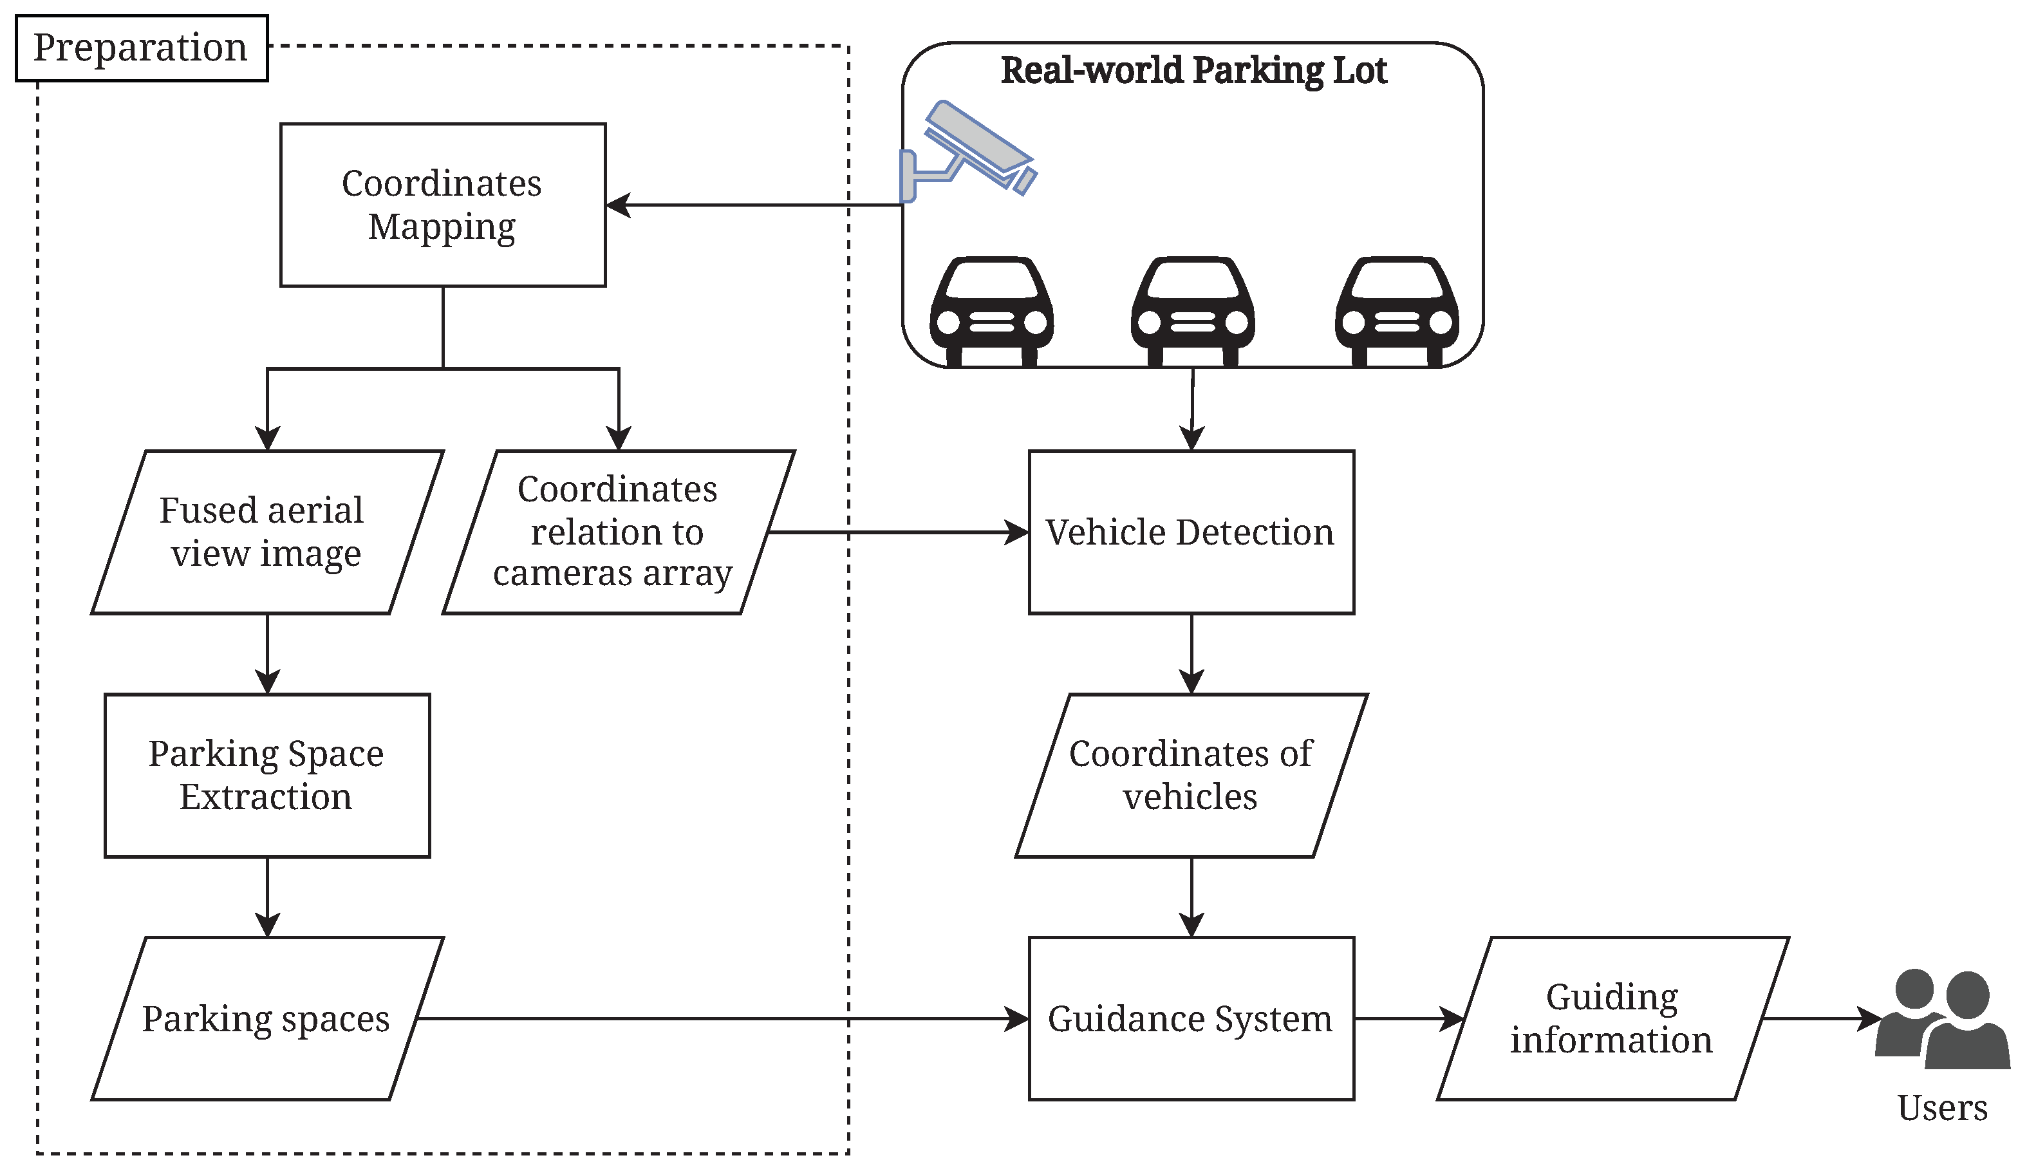
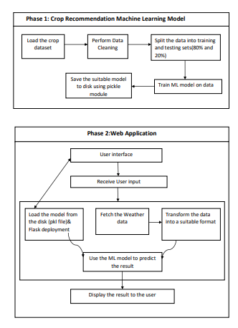
ARCHITECTURE:

Slide 10
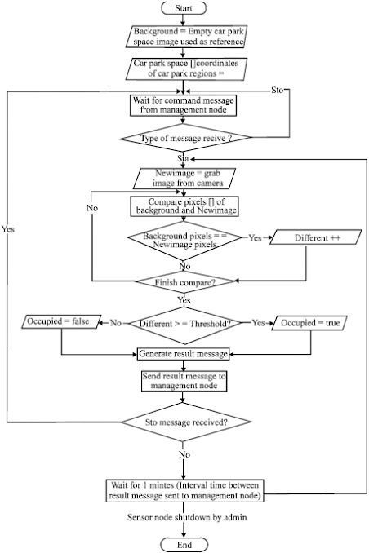
DESIGN:DATA FLOW DIAGRAM

Slide 11
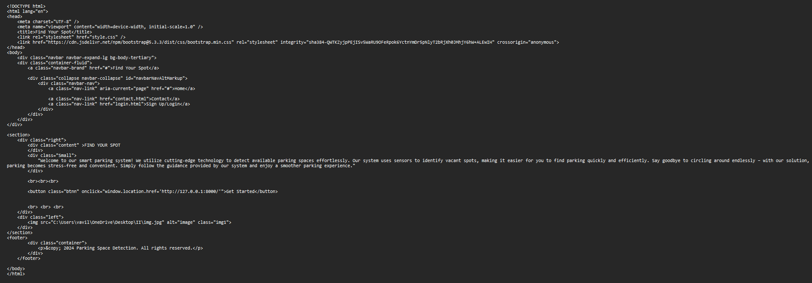
DEPLOYMENT AND RESULTS:SOURCE CODE
HOME PAGE CODE

Slide 12
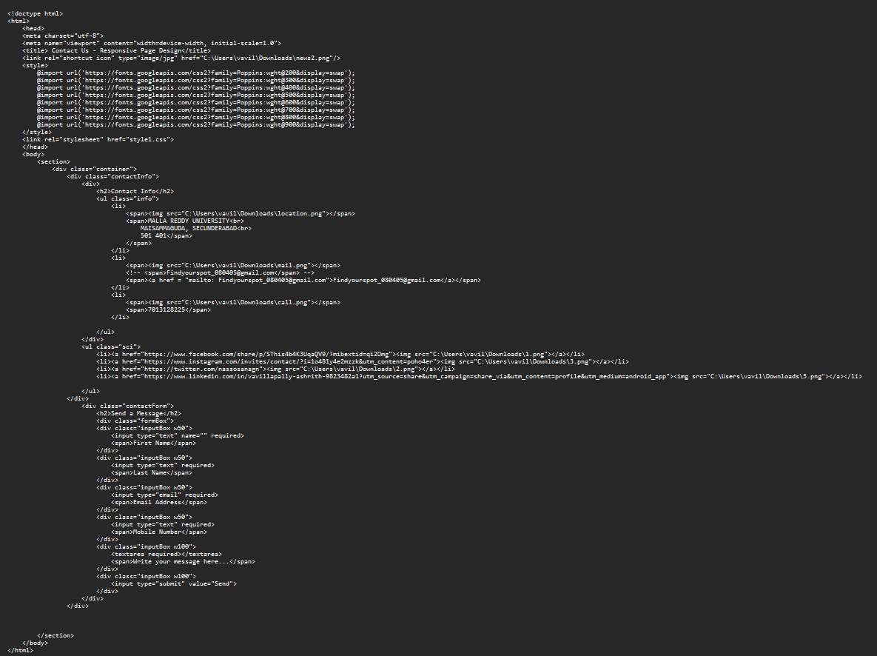
CONTACT US PAGE CODE:

Slide 13
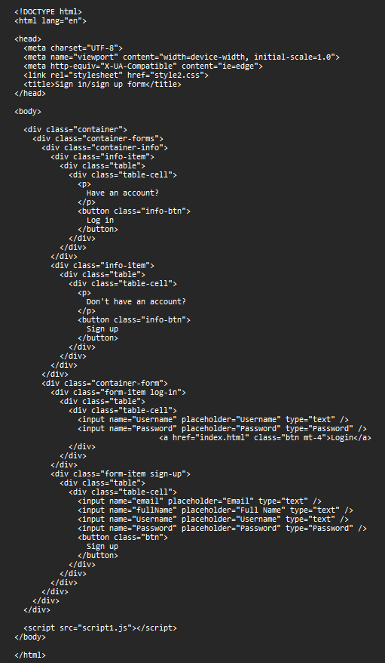
LOGIN PAGE CODE:

Slide 14
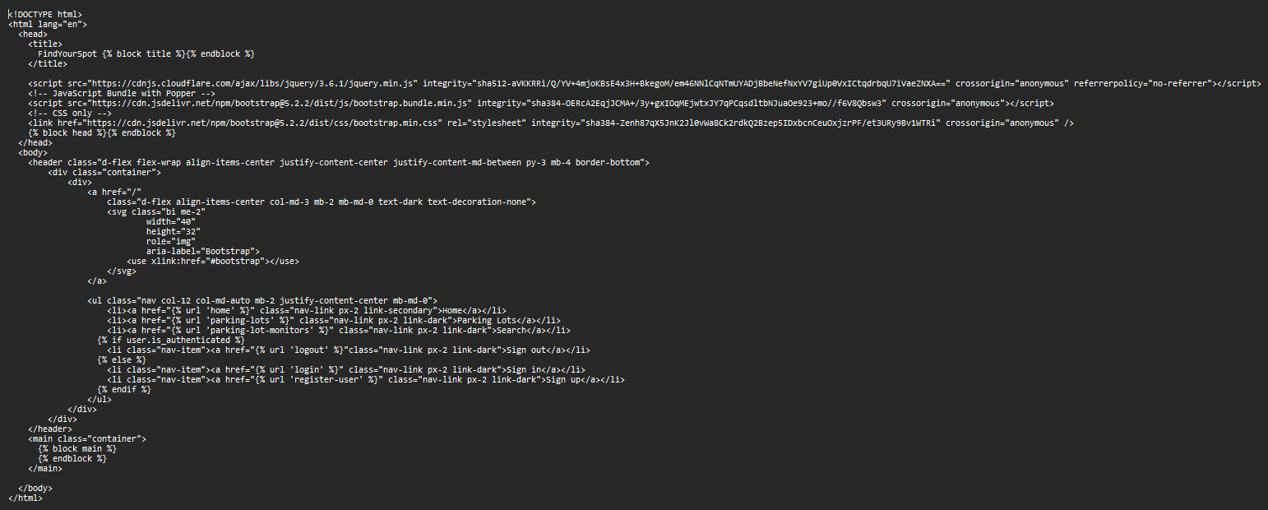

Slide 15
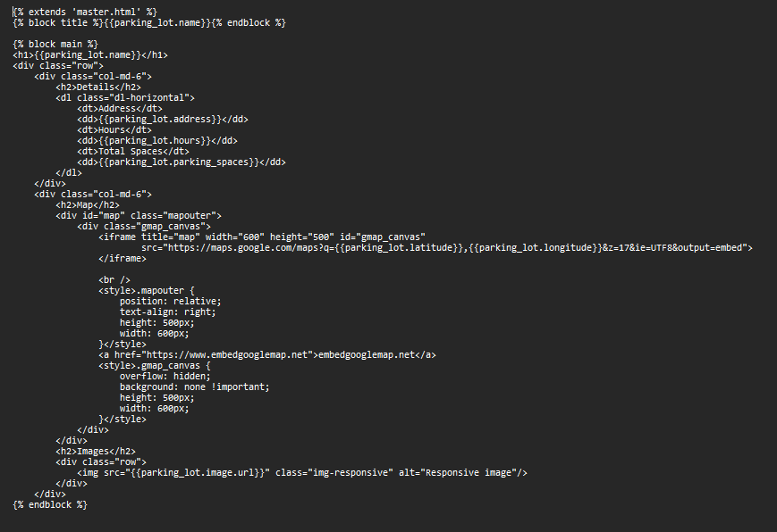

Slide 16
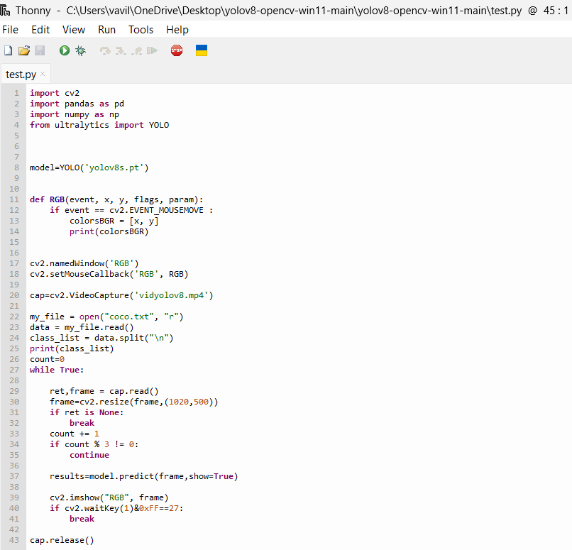
MODEL IMPLEMENTATION AND INTEGRATION:

Slide 17
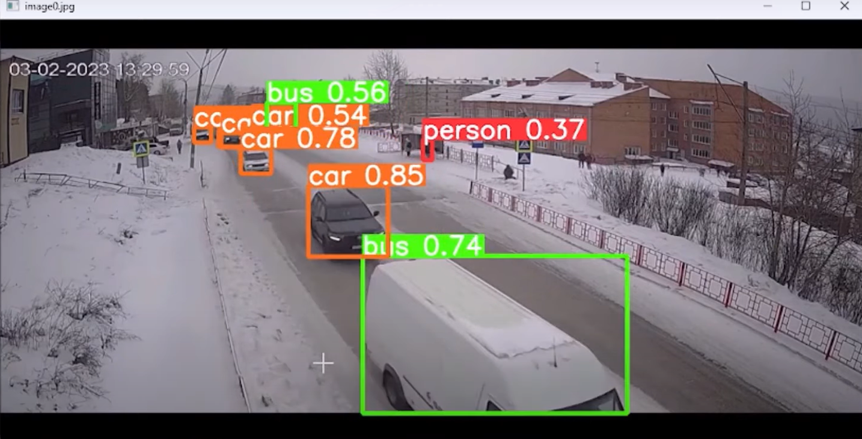
MODEL DEPLOYMENT:
OBJECT DETECTION:

Slide 18
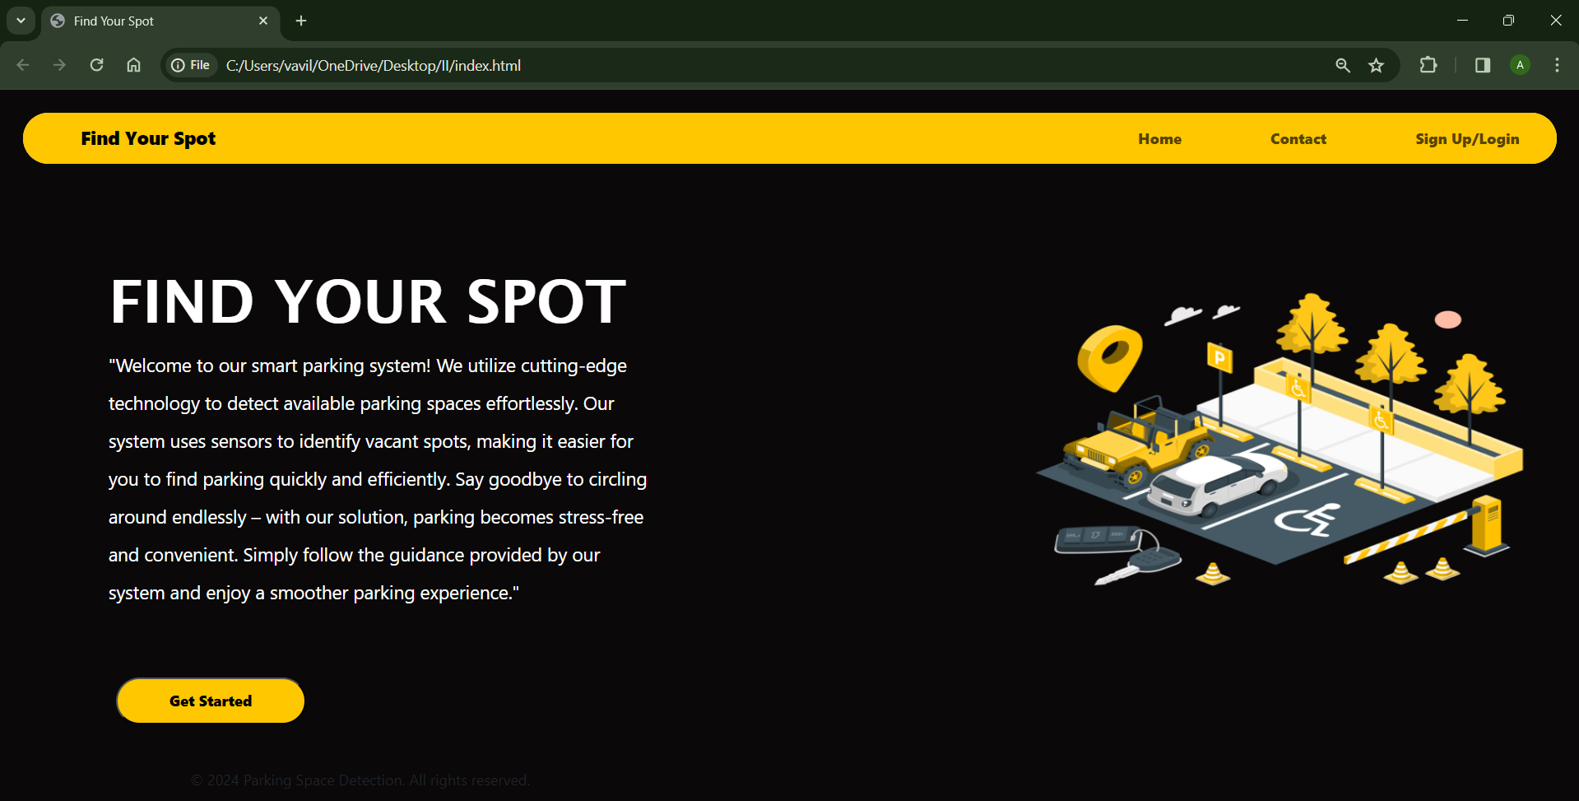
Web GUI’s Development & Integration:
GUI SCREEN:

Slide 19
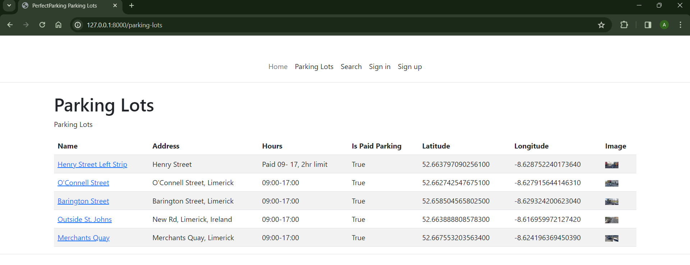

Slide 20
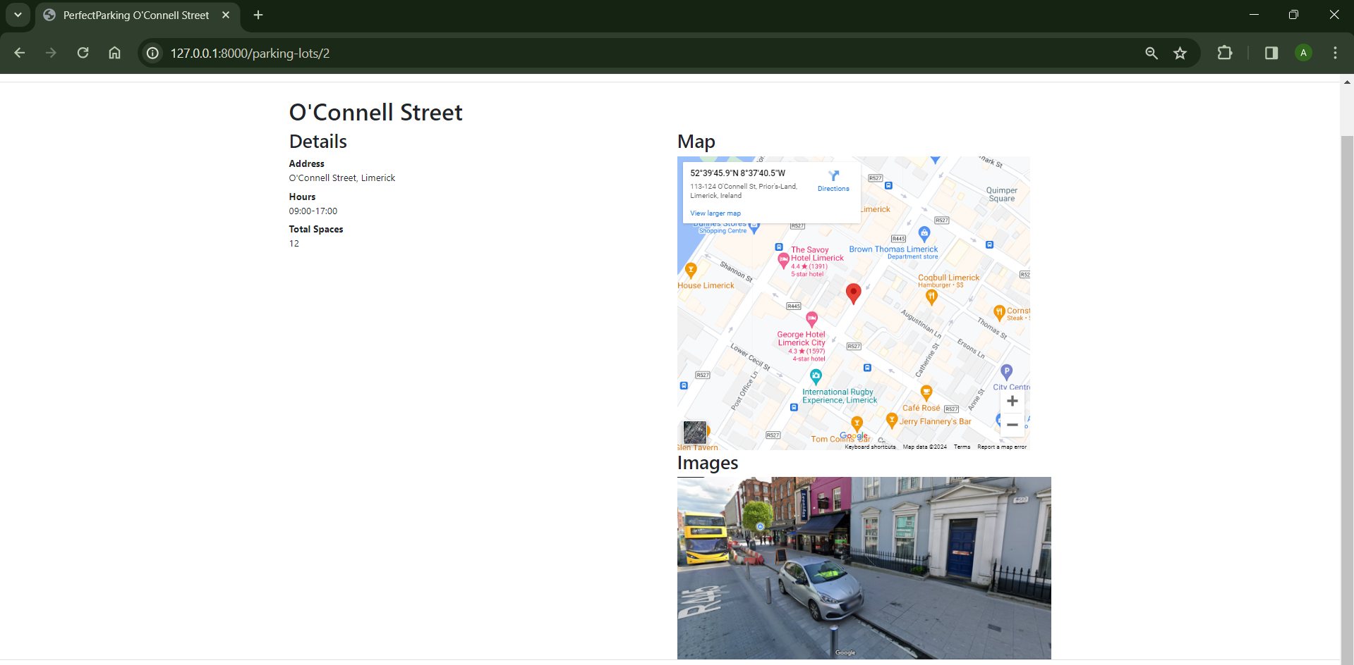

Slide 21
Project conclusion:
In conclusion, our Parking Space Detection project represents a significant step forward in optimizing urban mobility and enhancing the parking experience for drivers everywhere. Through the integration of advanced sensor technologies, real-time data processing, and user-friendly interfaces, we have successfully developed a solution that addresses the perennial challenges of parking space scarcity and inefficiency.Throughout the development process, we have achieved several key milestones. We've implemented robust algorithms capable of accurately detecting and categorizing parking spaces in various environments, from busy city streets to multi-level parking structures. Our system's ability to provide real-time updates ensures that drivers always have access to the most up-to-date information about available parking spots, reducing frustration and congestion.Moreover, our project goes beyond mere detection by offering additional features such as reservation capabilities and seamless navigation to reserved spaces. By empowering users to plan their parking in advance and navigate directly to their designated spots, we're streamlining the entire parking process and making it more convenient than ever before.Looking ahead, we envision further enhancements and potential expansions for our Parking Space Detection project. This may include integration with smart city infrastructure for enhanced connectivity and scalability, as well as the incorporation of machine learning techniques to continuously improve accuracy and efficiency.In summary, our Parking Space Detection project has not only demonstrated the feasibility of leveraging technology to alleviate parking challenges but has also laid the groundwork for a future where finding a parking spot is no longer a source of frustration but rather a seamless and stress-free experience.

Slide 22
FUTURE SCOPE:
The future of parking space detection is poised for transformative advancements across various fronts. From predictive analytics powered by machine learning algorithms to dynamic pricing models based on real-time demand, the evolution promises to revolutionize how we navigate urban parking landscapes. Integrating with smart city initiatives, parking space detection will become a pivotal component in optimizing traffic flow and reducing congestion. Augmented reality integration offers exciting prospects, providing users with enhanced visual cues for navigating to available spaces with precision. Moreover, the expansion of IoT sensors and connectivity will enable real-time monitoring of parking spots, while multi-modal integration will offer comprehensive mobility solutions. Environmental sustainability will also take center stage, with parking applications encouraging eco-friendly transportation choices and promoting accessibility features for individuals with disabilities. Robust security and privacy measures will ensure the protection of user data, while continuous enhancements in user experience will foster long-term engagement and satisfaction. Together, these advancements will redefine urban mobility, making parking a seamless, efficient, and sustainable experience for all.

Slide 23
THANKYOU

